Slide 1
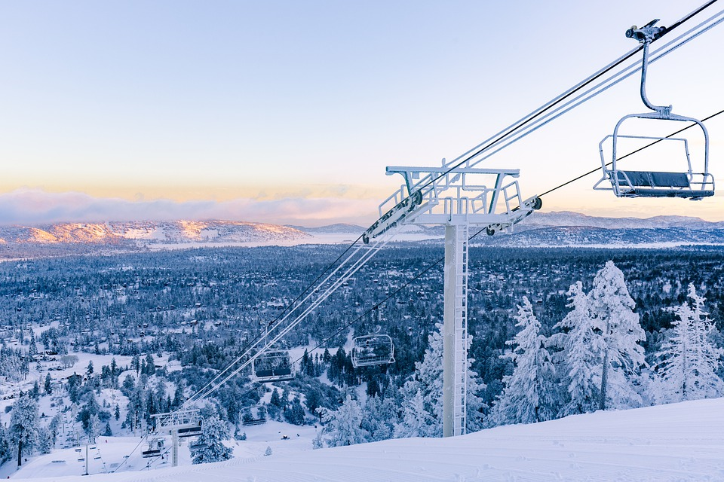
Big Mountain Resort
Problem Identification
&
Recommendations
By
Garrett Hass

Slide 2
Problem Identification
Context of Problem:
Big Mountain Resort recently installed a new chairlift. The chairlift increased their operating costs by $1,540,000 for the season. The resort's pricing strategy has been to charge a premium above the average price of resorts in its market segment. Big Mountain is probably not capitalizing on its facilities to its potential.Their current ticket price compared to the market average does not provide how important different facilities are to their guests. Their ticket price is undervalued. This hinders their business investment strategy.
Criteria for Success:
Implementing a data-driven business strategy to create more revenue. Selecting the best possible value for their ticket price with data and information based upon other resorts in the United States that they compete with. Find ways to cut costs without reducing the ticket price. Or creating new facilities to justify a higher ticket price will create new success for Big Mountain.
Scope of Success:
Utilizing an algorithm in python based upon other ski resort’s data and facilities in the United States to find the best possible ticket price that fits their market segment. This will also help them locate what facilities they need to add or remove to produce better revenue.

Slide 3
Problem Identification
Stakeholders:
-CEO
-CTO
-Data Science Team
-National Forest Service
-Alesha Eisen, Database Manager
-Board of Directors
-Shareholders
-Jimmy Blackburn, Director of Operations
-President
Key Data Sources:
-skiResort.csv

Slide 4
Recommendations
-I recommend that Big Mountain Resort increase their weekend price to $95.87 from $81.00.
-I would do an experiment for a certain amount of time and close just one ski run on the weekend to reduce maintenance cost.
-Adding a run, 150 vertical feet and a new chairlift, (fast quad) is what I highly suggest the resort enact.
This plan justifies a ticket price increase of $1.99 that improves revenue to $3,474,638 per year.
-Creating more space to ski and a new chairlift will prove why it is the most expensive ticket in Montana.
-Big Mountain needs to invest in facilities that guests value the most on their ski trips.
-The resort needs data on maintenance cost to make a solid decision going forward.
Key Findings
-Big Mountain offers more facilities and skiable terrain than most other resorts in the United States.
- In both of our models vertical drop, snow making, total chairs, fast quads, runs, longest run, trams and skiable terrain were the most important to guests.
-The resort is in the top portion of fast quads, runs, snow making, total chairs and vertical drop compared to other places.
-Most other resorts like Big Sky do not have a tram.

Slide 5
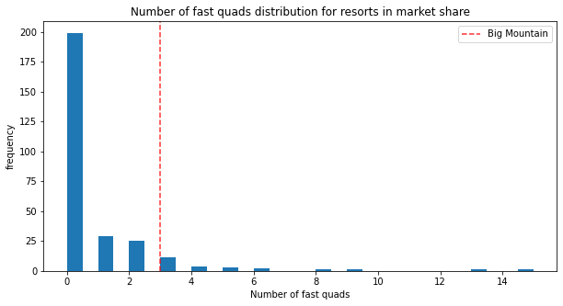
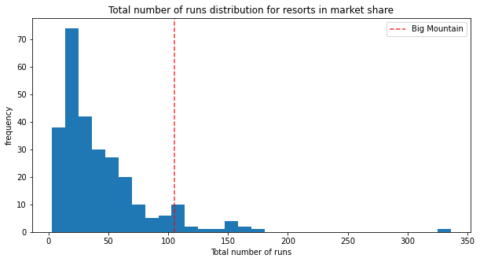
Modeling Results & Analysis
(Number of Fast Quads & Runs in Market)

Slide 6
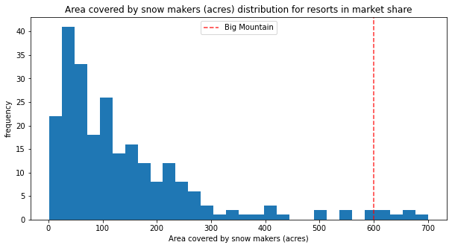
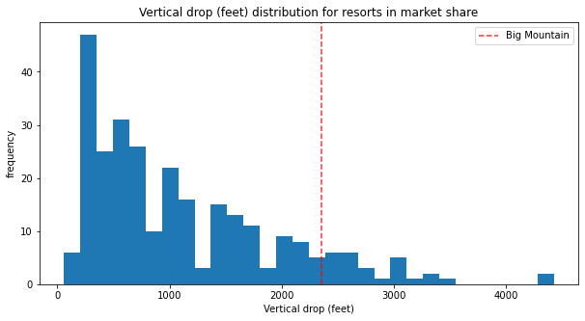
Modeling Results & Analysis
(Acres Covered by Snow Makers & Vertical Drop)

Slide 7
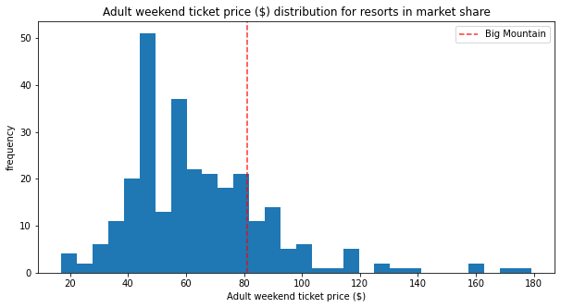
Modeling Results & Analysis
(Adult Weekend Ticket Price)

Slide 8
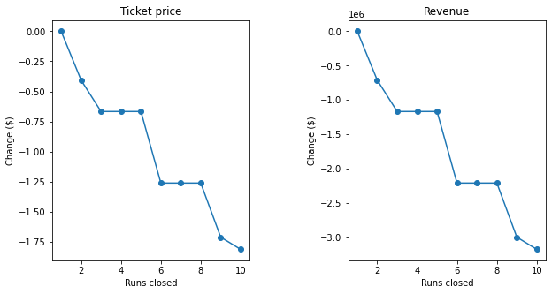
Modeling Results & Analysis
(Change in Ticket Price & Revenue per Run Closed)

Slide 9
Summary & Conclusion
The data suggests improving the adult weekend ticket price to $95.87 would increase revenue. Big Mountain is in the top portion of resorts in facilities offered. The resort is in the top portion of fast quads, runs, snow making and vertical drop. These four elements are why people pay more for a ticket when they go to a ski resort according to our Random Forest Model. I would close one ski run on the weekend to reduce maintenance cost for a certain amount of time. This would be worth experimenting with. I would take caution as closing more than one run reduces the justification for our ticket price. Reducing runs could also lead to a decrease in guests experience since it would put more people on less runs.
I highly recommend adding a run, 150 vertical feet and a new chairlift that is a fast quad. This scenario vindiacates a price increase of $1.99 that would improve revenue to $3,474,638 per year. If the chairlift, extra grooming and permit from the National Forest Service is worth the cost it could lead to more revenue.

